Slide 1


Azure AD Domain Services Domain Controllers in the Cloud?
Sam Cogan
Solution Architect, Willis Towers Watson & Microsoft MVP

Slide 2


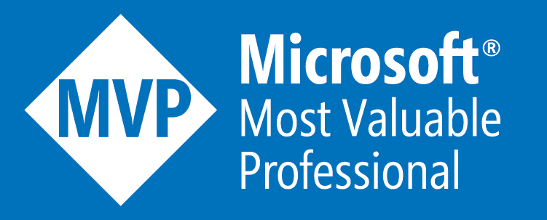


About Me
Sam Cogan
Solution Architect – Willis Towers Watson
Microsoft Azure MVP
samcogan.com
@samcogan
samcogan

Slide 3

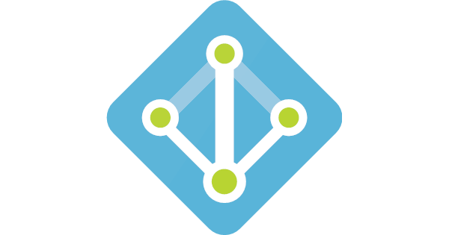
In The Beginning!

Slide 4
How do I join machines to this domain?
Where has DNS gone?
I can still do LDAP queries right?
Where do I setup Group Policy?
My application needs LDAP

Slide 5
In The Beginning!

Slide 6

Your scientists were so preoccupied with whether or not they could, that they didn’t stop to think if they should.

Slide 7
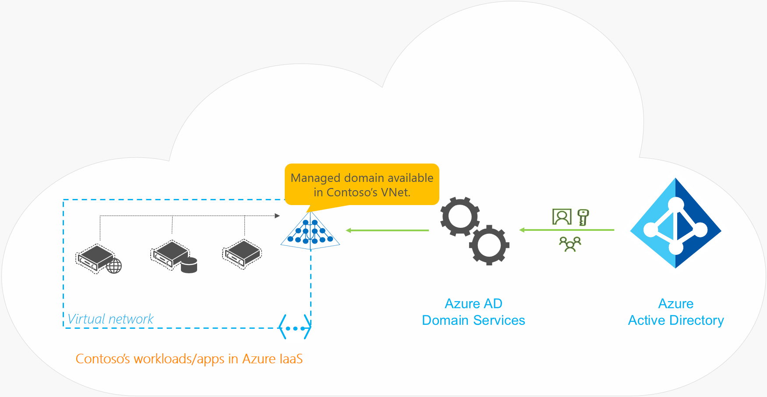
Deployment Scenarios

Slide 8
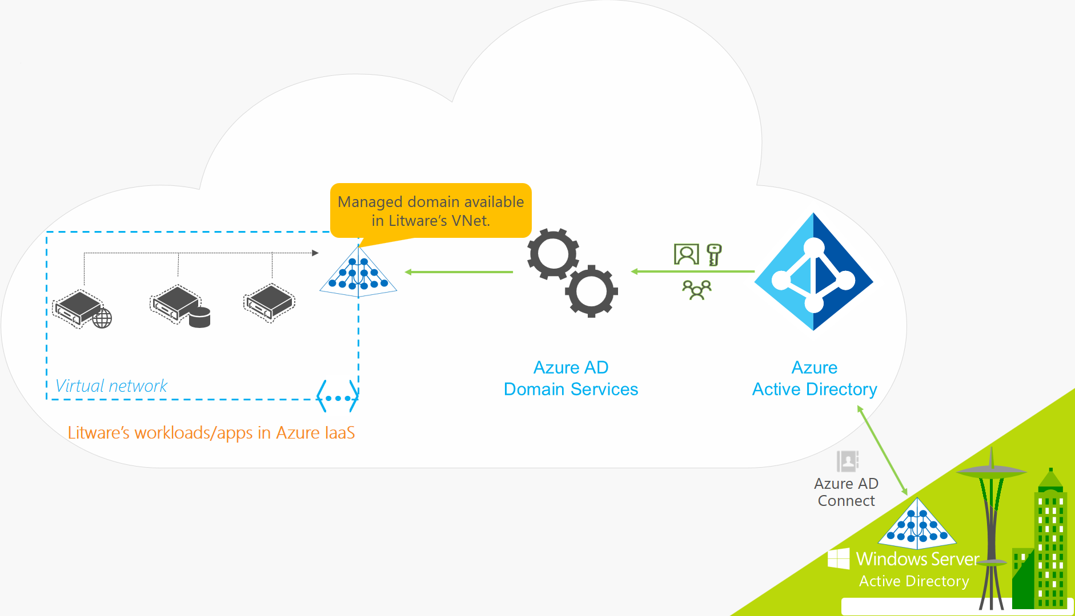
Deployment Scenarios

Slide 9
AAD DS Demo

Slide 10



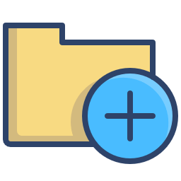
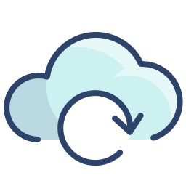



Benefits
Simple Deployment
No management overhead
High availability built in
GPO Support
Achieve AAD to AD Sync
JIT Admin Support
No VPN or Express Route
LDAP, NTLM, Kerberos

Slide 11



Resolved Issues
Classic vNet Only
No Custom OUs
No Custom GPOs
No support for Kerberos Delegation
Not available in CSP

Slide 12
Current Issues
- Multi Region Support
- Domain Admin Rights
- User Creation
- Hybrid Sync
- Custom OUs & GPOs
- Kerberos Delegation
Classic vNet Only
No Custom OUs
No Custom GPOs
No support for Kerberos Delegation
Not available in CSP

Slide 13

Multi Region Support

Slide 14

Domain Admin Rights

Slide 15
About Me
Sam Cogan
Solution Architect – Willis Towers Watson
Microsoft Azure MVP
samcogan.com
@samcogan
samcogan

